Slide 1




Computer Networks
Addressing the Network: IPv4
Lecturer: Sura F. Ismail
Lecture Nine
Second Class.
Time: 9: 30- 11:30
Department: Informatics Systems Management (ISM)

Slide 2

Outline
Outline
Overview
IPv4 Addresses
Addressing Types of Communication: Unicast, Broadcast, Multicast
IPv4 Addresses for Different Purposes
Assigning Addresses

Slide 3
1. Overview
Outline
Addressing is a key function of network layer protocols. Addressing enables data communication between hosts on the same network or on different networks. Internet Protocol version 4 (IPv4) provides hierarchical addressing for packets that carry your data. Designing, implementing, and managing an effective IPv4 addressing plan ensures that networks can operate effectively and efficiently. This lecture and the next lecture examine in detail the structure of IPv4 addresses and their application to the construction and testing of IP networks and subnetworks.

Slide 4
2. IPv4 Addresses
Outline
For communication to take place between hosts, the appropriate addresses must be applied to these devices. Managing the addressing of the devices and understanding the IPv4 address structure and its representation are essential.
Anatomy of an IPv4 Address
Each device on a network must be uniquely defined by a network layer address. At this layer, the packets of the communication are also identified with the source and destination addresses of the two end systems. With IPv4, each packet uses a 32-bit source address and a 32-bit destination address in the Layer 3 header. These addresses are represented in the data network as binary patterns. Inside the devices, digital logic is applied for the interpretation of these addresses. For the human network, a string of 32 bits is difficult to interpret and even more difficult to remember. For this reason, IPv4 addresses are represented using dotted decimal format.

Slide 5
2. IPv4 Addresses
Outline
Dotted Decimal
IPv4 addresses are easier to remember, write, and verbally communicate than strings of 32 bits. Representing IPv4 addresses as dotted decimals begins by separating the 32 bits of the address into bytes. Each byte of the binary pattern, called an octet, is separated with a dot. The bytes are called an octet, because each of the decimal numbers represents 1 byte, or 8 bits. For example, the following address: 10101100000100000000010000010100
is expressed in dotted decimal as 172.16.4.20
Keep in mind that devices use binary logic. The dotted decimal format makes it easier for people to use and remember addresses.

Slide 6
2. IPv4 Addresses
Outline
IPv4 addresses have two parts: the network portion and the host portion. For each IPv4 address, some portion of the most significant bits, or high-order bits, represents the network address. At Layer 3, a network is defined as a group of hosts that have identical bit patterns in the network address portion of their addresses. That is, all the bits in the network portion of their addresses are identical. In the following example, the two addresses have identical network portions. Therefore, hosts assigned these two addresses would be on the same logical network:
172.16.4.20 172.16.4.32
network host network host
portion portion portion portion

Slide 7
2. IPv4 Addresses
Outline
Although all 32 bits define the IPv4 host address, a variable number of bits represent the host portion of the address. The number of bits used in this host portion determines the number of hosts within the network. In the previous example, the last octet, the lowest 8 bits, are the host portion. This means that the bits for the upper three octets represent the network portion.
You determine how many bits are required for the host portion based on the number of hosts that a network requires. If a particular network requires at least 200 hosts, you would need to use enough bits in the host portion to be able to represent at least 200 different bit patterns. To assign a unique address to 200 hosts, you would use the entire last octet. With 8 bits, a total of 256 different bit patterns can be achieved. As with the previous example, this means that the bits for the upper three octets represent the network portion.

Slide 8
3. Addressing Types of Communication: Unicast, Broadcast, Multicast
Outline
Addressing Types of Communication: Unicast, Broadcast, Multicast
In an IPv4 network, the hosts can communicate in one of three different ways:
Unicast: The process of sending a packet from one host to an individual host
Broadcast: The process of sending a packet from one host to all hosts in the network
Multicast: The process of sending a packet from one host to a selected group of hosts
Each of these three types supports different types of communication in the data networks and uses different IPv4 destination addresses. In all three cases, the IPv4 address of the originating host is placed in the packet header as the source address.

Slide 9
4. IPv4 Addresses for Different Purposes
Outline
Besides the addresses in the IPv4 address range that are reserved for multicast, many of the IPv4 unicast addresses have been reserved for special purposes. Some of these addresses limit the scope or functionality of the hosts to which they are assigned. Other reserved addresses cannot be assigned to hosts. In the next sections, some of these reserved addresses will be presented.
Types of Addresses in an IPv4 Network Range
Within each IPv4 network, there are three types of addresses:
Network address: A special address that refers to the network
Broadcast address: A special address used to send data to all hosts in the network
Host addresses: The unicast addresses assigned to the end devices in the network
Within each network, there are two addresses that cannot be assigned to devices: network address and broadcast address. The other addresses allocated to a network are the host addresses to be assigned to the individual devices.

Slide 10
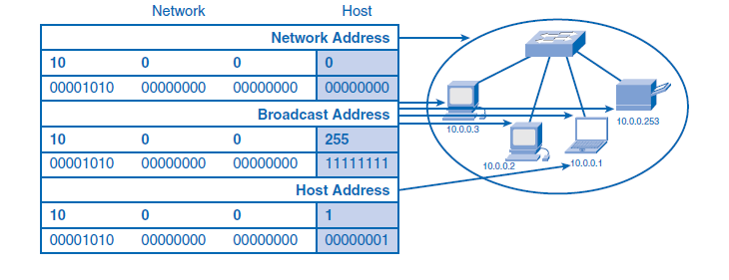
4. IPv4 Addresses for Different Purposes
Outline

Slide 11
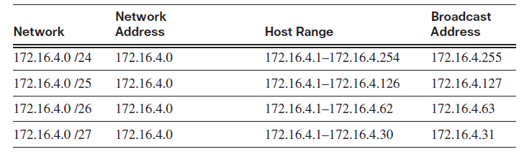
4. IPv4 Addresses for Different Purposes
Outline
Network Prefixes
When you examine a network address, you might ask, “How do you know how many bits of this address represent the network portion and how many bits represent the host portion?” The answer is the prefix mask. When an IPv4 network address is expressed, you add a prefix length to the network address. This prefix length is the number of bits in the address that gives the network portion. This prefix length is written in slash format. That is a forward slash (/) followed by the number of network bits. For example, in 172.16.4.0 /24, the /24 is the prefix length. This tells you that the first 24 bits are the network address. The remaining 8 bits, the last octet, are the host portion.
Networks are not always assigned a /24 prefix. Depending on the number of hosts on the network, the prefix assigned can be different. Having a different prefix number changes the host range and broadcast address for each network.

Slide 12
4. IPv4 Addresses for Different Purposes
Outline
Subnet Mask: Defining the Network and Host Portions of the Address
Another question you might ask is, “How do the network devices know how many bits are the network portion and how many bits are the host portion?” The answer to this question is the subnet mask. The prefix and the subnet mask are different ways of representing the same information: the network portion of an address. The prefix length tells you the number of bits in the address that are the network portion in a way that is easier to communicate to humans. The subnet mask is used in data networks to define this network portion for the devices. The subnet mask is a 32-bit value used with the IPv4 address that specifies the network portion of the address to the network devices. The subnet mask uses 1s and 0s to indicate which bits of the IPv4 address are network bits and which bits are hosts bits. The subnet mask is expressed in the same dotted decimal format as the IPv4 address.

Slide 13
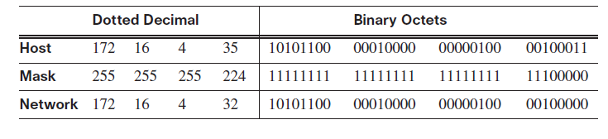
4. IPv4 Addresses for Different Purposes
Outline
The subnet mask is created by placing a binary 1 in each appropriate bit position that represents a network bit of the address and placing a binary 0 in the remaining bit positions that represent the host portion of the address. A /24 prefix represents a subnet mask of 255.255.255.0 (11111111.11111111.11111111.00000000). The first three octets, the higher-order 24 bits, are all 1s. The remaining low-order bits of the subnet mask are 0s, indicating the host address within the network.

Slide 14
4. IPv4 Addresses for Different Purposes
Outline
IPv4 Experimental Address Range
Expressed in dotted decimal format, the IPv4 address range is 0.0.0.0 to 255.255.255.255. As you have already seen, not all these addresses can be used as unicast host addresses for unicast communication. Recall that the block of addresses from 224.0.0.0 to 239.255.255.255 is reserved for the addressing of multicast groups. All the IPv4 addresses higher than the multicast range are also reserved for special purposes. Except for the limited broadcast address of 255.255.255.255, the address range of 240.0.0.0 to 255.255.255.254 is the IPv4 experimental addresses. Currently, these addresses are listed as reserved for future use (RFC 3330). This suggests that they could be converted to usable addresses. Currently, they cannot be used in IPv4 networks. However, these addresses are used for research or experimentation.
After accounting for the ranges reserved for experimental addresses and multicast addresses, this leaves an address range of 0.0.0.0 to 223.255.255.255 that could be used for IPv4 hosts. However, this range includes many addresses that are already reserved for special purposes. Although some of these addresses have been previously presented, the major reserved addresses are discussed in the next sections.

Slide 15
4. IPv4 Addresses for Different Purposes
Outline
Public and Private Addresses
Although most IPv4 host addresses are public addresses designated for use in networks that are accessible on the Internet, there are blocks of addresses used in networks that require limited or no Internet access. These addresses are called private addresses. The private address blocks are
10.0.0.0 /8 (10.0.0.0 to 10.255.255.255)
172.16.0.0 /12 (172.16.0.0 to 172.31.255.255)
192.168.0.0 /16 (192.168.0.0 to 192.168.255.255)
Private space address blocks are set aside for use in private networks. The use of these addresses need not be unique among outside networks. Hosts that do not require access to the Internet at large can make unrestricted use of private addresses. However, the internal networks still must design network address schemes to ensure that the hosts in the private networks use IP addresses that are unique within their networking environment. Many hosts in different networks can use the same private space addresses.

Slide 16
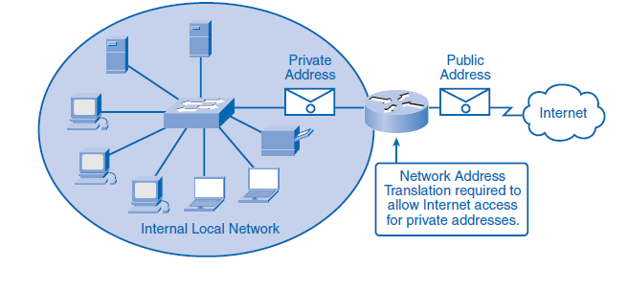
4. IPv4 Addresses for Different Purposes
Outline
Packets using these addresses as the source or destination should not appear on the public Internet. The router or firewall device at the perimeter of these private networks must block or translate these addresses. Even if these packets were to make their way to the Internet, the routers would not have routes to forward them to the appropriate private network. Because packets with private space destination addresses are not routable across the Internet, services to translate packets from hosts using private addresses are required. These services, called Network Address Translation (NAT), can be implemented on a device at the edge of the private network. At the perimeter router, NAT changes the private space addresses in the IPv4 packet header to a public space address.

Slide 17
4. IPv4 Addresses for Different Purposes
Outline
Special Unicast IPv4 Addresses
In addition to the addresses that cannot be assigned to hosts, special addresses can also be assigned to hosts but with restrictions on how those hosts can interact within the network. These special addresses include the following:
Default route
Loopback address
Link-local address
Test-net addresses
The following sections summarize these special IPv4 addresses.
Default Route
The IPv4 default route is 0.0.0.0. This default route is a “catch all” route to route packets when a more specific route is not available. The use of this address also reserves all addresses in the 0.0.0.0 /8 address block (0.0.0.0–0.255.255.255).

Slide 18
4. IPv4 Addresses for Different Purposes
Outline
Loopback
Another reserved address block is 127.0.0.0 /8 (127.0.0.0 to 127.255.255.255). This is reserved in the IPv4 hosts for the 127.0.0.1 loopback. The loopback is a special address that hosts use to direct traffic to themselves. Any address within this block will loop back within the local host. No address within this block should ever appear on any network.
Link-Local Addresses
IPv4 addresses in the 169.254.0.0 /16 address blocks (169.254.0.0 to 169.254.255.255) are designated as link-local addresses. These addresses can be automatically assigned to the local host by the operating system in environments where no IP configuration is available. These might be used in a small peer-to-peer network or for a host that could not automatically obtain an address from a Dynamic Host Configuration Protocol (DHCP) server. Communication using IPv4 link-local addresses is only suitable for communication with other devices connected to the same network.

Slide 19
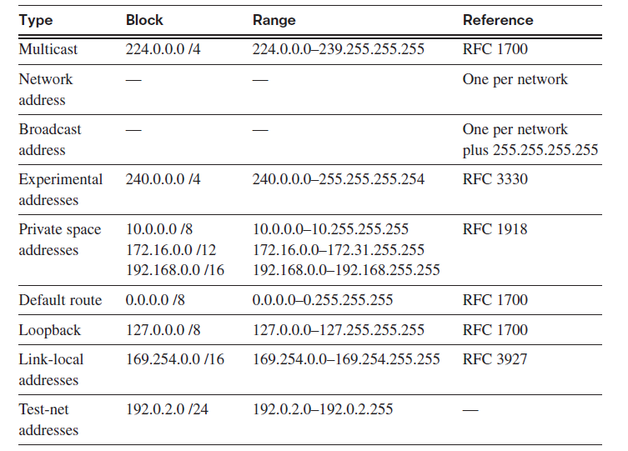
4. IPv4 Addresses for Different Purposes
Outline
Test-Net Addresses
The test-net addresses are set aside for teaching and learning purposes. This is the address block 192.0.2.0 /24 (192.0.2.0 to 192.0.2.255). These addresses can be used in documentation and network examples. Unlike the experimental addresses, network devices will accept the test-net addresses in their configurations. You can often find these addresses used with the domain names example.com or example.net in RFCs and vendor and protocol documentation. Addresses within this block should not appear on the Internet.

Slide 20
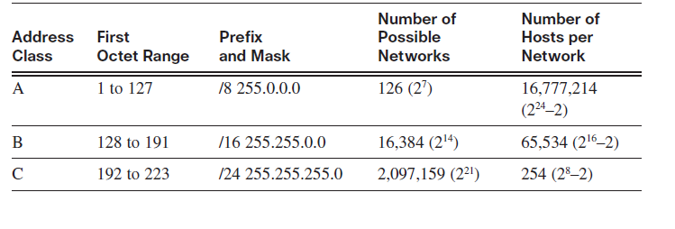
4. IPv4 Addresses for Different Purposes
Outline
Legacy IPv4 Addressing
In the early 1980s, the IPv4 addressing range was divided into three different classes: class A, class B, and class C. Each class of addresses represented networks of a specific fixed size.

Slide 21
4. IPv4 Addresses for Different Purposes
Outline
Limits to the Classful Addressing System
Not all organizations’ addressing requirements fit well into one of these three classes. Classful allocation of address space often wasted many addresses, which exhausted the availability of IPv4 addresses. For example, a company that had a network with 260 hosts would need to be given a class B address with more than 65,000 addresses. Even though this classful system was all but abandoned in the late 1990s, the remnants of it are in effect in networks today. For example, when you assign an IPv4 address to a computer, the operating system examines the address being assigned to determine whether it is a class A, class B, or class C address.
The operating system then assumes the prefix used by that class and makes the appropriate subnet mask assignment. Another example is the assumption of the mask by some routing protocols. When some routing protocols receive an advertised route, it can assume the prefix length based on the class of the address.
Classless Addressing
The system that is currently in use is referred to as classless addressing. With the classless system, address blocks appropriate to the number of hosts are assigned to companies or organizations without regard to the unicast class. Associated with this classless addressing system are other practices, such as using networks of fixed sized, that have made IPv4 addressing more viable.

Slide 22
5. Assigning Addresses
Outline
Network personnel must design the addresses scheme for the network. The following sections present the practices and processes of providing addresses for networks.
Planning to Address the Network
The allocation of network layer address space within the corporate network needs to be well designed. Network administrators should not randomly select the addresses used in the networks. Network administrators should plan and document the allocation of these addresses inside the networks for the following purposes:
Preventing duplication of addresses
Providing and controlling access
Monitoring security and performance

Slide 23
5. Assigning Addresses
Outline
Assigning Addresses Within a Network
As you have already learned, hosts are associated with an IPv4 network by a common network portion of the address. Within a network, there are different types of hosts, such as the following:
End devices for users
Servers and peripherals
Hosts that are accessible from the Internet
Intermediary devices
Each of these different device types should be allocated to a logical block of addresses within the address range of the network. An important part of planning an IPv4 addressing scheme is deciding when private addresses are to be used and where they are to be applied. Considerations include the following:
Will there be more devices connected to the network than public addresses allocated by the network ISP?
Will the devices need to be accessed from outside the local network?
If devices that can be assigned private addresses require access to the Internet, is the network capable of providing a Network Address Translation (NAT) service?
If there are more devices than available public addresses, only those devices that will directly access the Internet, such as web servers, require a public address. A NAT service would allow those devices with private addresses to effectively share the remaining public addresses.

Slide 24
5. Assigning Addresses
Outline
Static or Dynamic Addressing for End-User Devices
Addresses in the network can be assigned to hosts statically or dynamically.
Addresses for User Devices
In most data networks, the largest population of hosts includes the end devices such as PCs, IP phones, printers, and PDAs. Because this population represents the largest number of devices within a network, the largest number of addresses should be allocated to these hosts. IP addresses can be assigned either statically or dynamically.
Static Assignment of Addresses
With a static assignment, the network administrator must manually configure the network information for a host. At a minimum, this includes entering the host IP address, subnet mask, and default gateway.. Static addresses have some advantages over dynamic addresses. For example, they are useful for printers, servers, and other networking devices that need to be accessible to clients on the network. If hosts normally access a server at a particular IP address, it would cause problems if that address changed. Additionally, static assignment of addressing information can provide increased control of network resources. However, it can be time consuming to enter the information on each host.

Slide 25
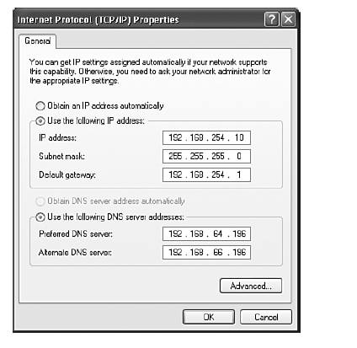
5. Assigning Addresses
Outline
Because a duplicated address affects the host operation, care must be taken not to reuse an address. When using static IP addressing, it is necessary to maintain an accurate list of the IP address assigned to each device.

Slide 26
5. Assigning Addresses
Outline
Dynamic Assignment of Addresses
Because of the challenges associated with static address management, end-user devices often have addresses dynamically assigned, using DHCP. DHCP enables the automatic assignment of addressing information such as IP address, subnet mask, default gateway, and other configuration information. The configuration of the DHCP server requires that a block of addresses, called an address pool, be defined to be assigned to the DHCP clients on a network. Addresses assigned to this pool should be planned so that they exclude any addresses used for the other types of devices.
DHCP is generally the preferred method of assigning IP addresses to hosts on large networks because it reduces the burden on network support staff and virtually eliminates entry errors.
Another benefit of DHCP is that an address is not permanently assigned to a host but is only “leased” for a period of time. If the host is powered down or taken off the network, the address is returned to the pool for reuse. This feature is especially helpful for mobile users who come and go on a network.

Slide 27
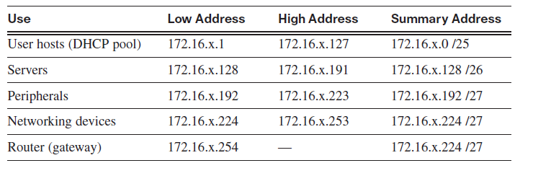
5. Assigning Addresses
Outline
Selecting Device Addresses
When determining the addresses to be assigned within the network, similar devices should be grouped into address ranges. These address ranges should be distinguishable. By examining an address, you should be able to determine what kind of device originates the packet.
Addresses for Servers and Peripherals
Addresses for Hosts That Are Accessible from the Internet
Addresses for Intermediary Devices
Addresses for Routers and Firewalls

Slide 28


THANK YOU

